Slide 1
Intro to Next Generation Sequencing Data Analysis with Galaxy
Rebecca Batorsky
Pr Bioinformatics Scientist
Nov 2021

Slide 2










Research Technology Team
Consultation on Projects and Grants
High Performance Compute Cluster
Workshops
https://it.tufts.edu/research-technology

Slide 3
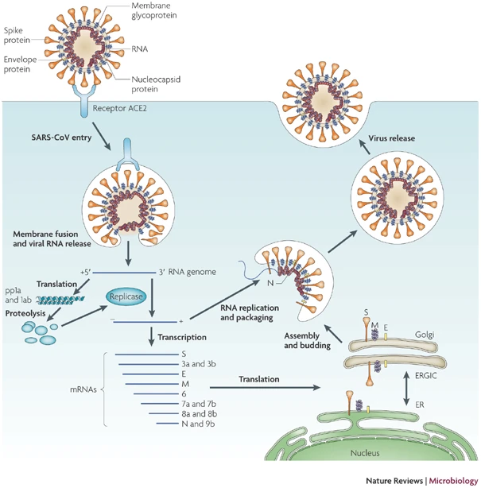
SARS-CoV lifecycle
Point out RNA
Point out Spike
https://www.nature.com/articles/nrmicro2090
Notes:
Severe acute respiratory syndrome-coronavirus (SARS-CoV) enters target cells through an endosomal pathway^{113,121,125,126,127}. S protein first binds to the cellular receptor angiotensin-converting enzyme 2 (ACE2)¹²⁹, and the ACE2–virus complex is then translocated to endosomes, where S protein is cleaved by the endosomal acid proteases (cathepsin L)¹⁰⁵ to activate its fusion activity. The viral genome is released and translated into viral replicase polyproteins pp1a and 1ab, which are then cleaved into small products by viral proteinases. Subgenomic negative-strand templates are synthesized from discontinuous transcription on the plus-strand genome and serve as templates for mRNA synthesis. The full-length negative-strand template is made as a template for genomic RNA. Viral nucleocapsids are assembled from genomic RNA and N protein in the cytoplasm, followed by budding into the lumen of the ERGIC (endoplasmic reticulum (ER)–Golgi intermediate compartment)¹²⁸. Virions are then released from the cell through exocytosis.

Slide 4
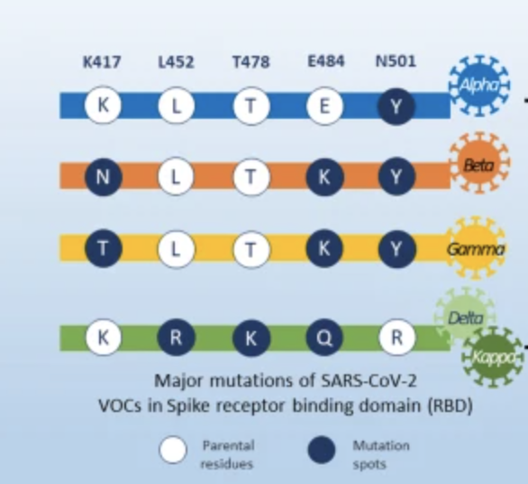
SARS-CoV2 Variants of Concern
https://ccforum.biomedcentral.com/articles/10.1186/s13054-021-03662-x

Slide 5

https://www.ncbi.nlm.nih.gov/sars-cov-2/
Notes:
Severe acute respiratory syndrome-coronavirus (SARS-CoV) enters target cells through an endosomal pathway^{113,121,125,126,127}. S protein first binds to the cellular receptor angiotensin-converting enzyme 2 (ACE2)¹²⁹, and the ACE2–virus complex is then translocated to endosomes, where S protein is cleaved by the endosomal acid proteases (cathepsin L)¹⁰⁵ to activate its fusion activity. The viral genome is released and translated into viral replicase polyproteins pp1a and 1ab, which are then cleaved into small products by viral proteinases. Subgenomic negative-strand templates are synthesized from discontinuous transcription on the plus-strand genome and serve as templates for mRNA synthesis. The full-length negative-strand template is made as a template for genomic RNA. Viral nucleocapsids are assembled from genomic RNA and N protein in the cytoplasm, followed by budding into the lumen of the ERGIC (endoplasmic reticulum (ER)–Golgi intermediate compartment)¹²⁸. Virions are then released from the cell through exocytosis.

Slide 6
Outline
Introduction to the Galaxy Platform
Obtain data from NCBI
Process Raw Reads (QC, adapter trimming)
Read Alignment
Visualization

Slide 7
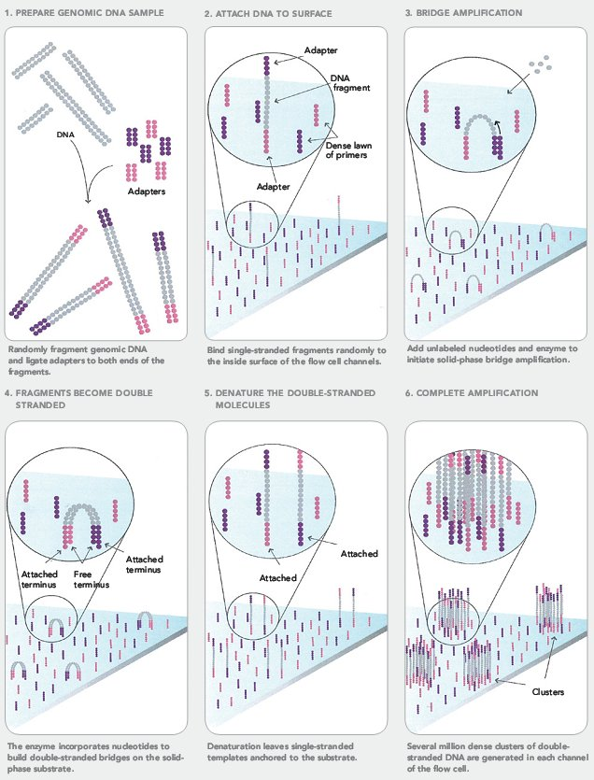
Next Generation Sequencing (NGS)
https://sites.google.com/site/himbcorelab/illumina_sequencing

Slide 8
Next Generation Sequencing (NGS)
https://sites.google.com/site/himbcorelab/illumina_sequencing

Slide 9
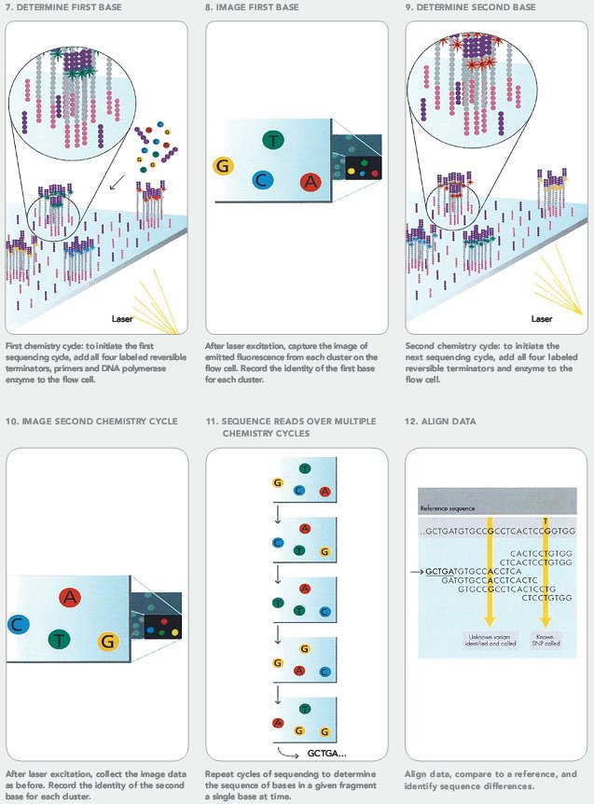
Next Generation Sequencing (NGS)
https://sites.google.com/site/himbcorelab/illumina_sequencing

Slide 10
Next Generation Sequencing (NGS)
This Illumina video is great for visualization!
https://sites.google.com/site/himbcorelab/illumina_sequencing

Slide 11
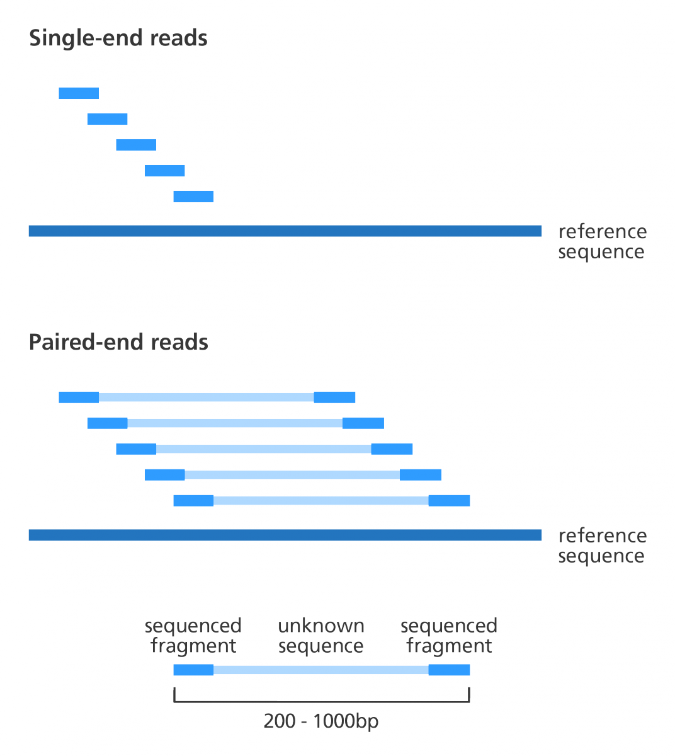
Paired end vs Single end reads
“Insert Size”
https://www.biostars.org/p/267167/

Slide 12
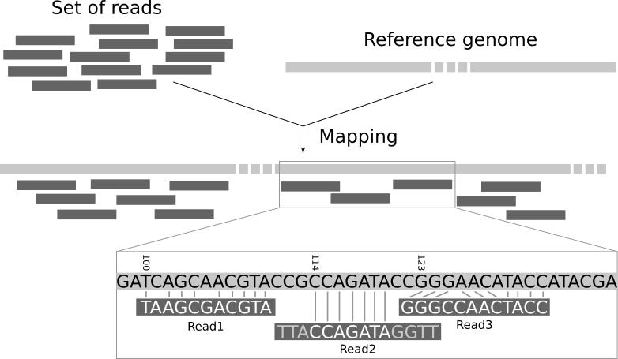
High level intro to Short Read Alignment
Notes:
Figure 1: Illustration of the mapping process. The input consists of a set of reads and a reference genome. In the middle, it gives the results of mapping: the locations of the reads on the reference genome. The first read is aligned at position 100 and the alignment has two mismatches. The second read is aligned at position 114. It is a local alignment with clippings on the left and right. The third read is aligned at position 123. It consists of a 2-base insertion and a 1-base deletion.

Slide 13



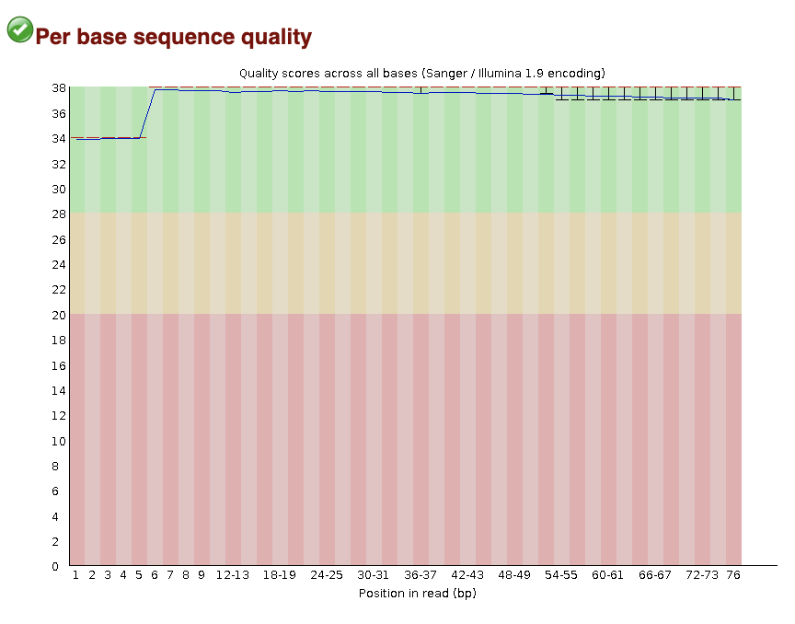
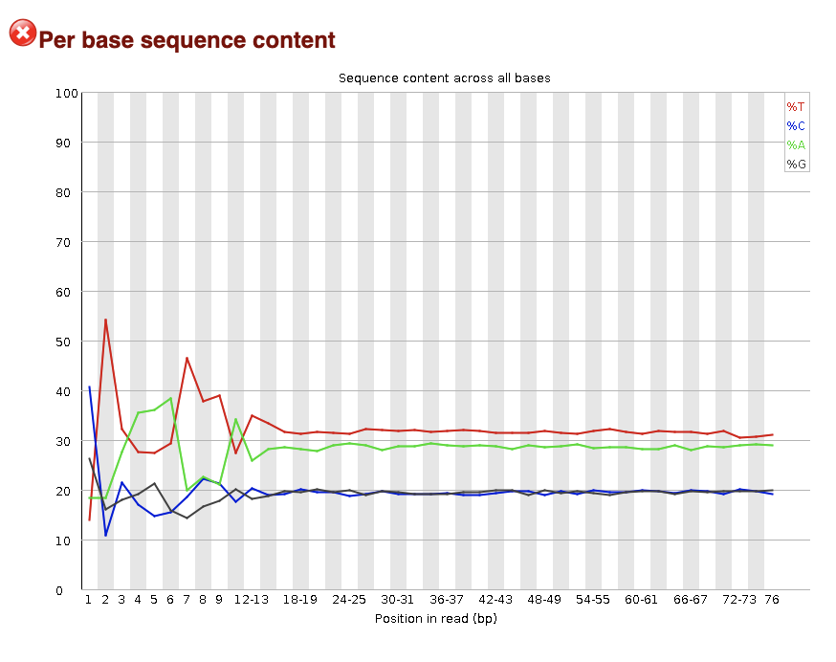
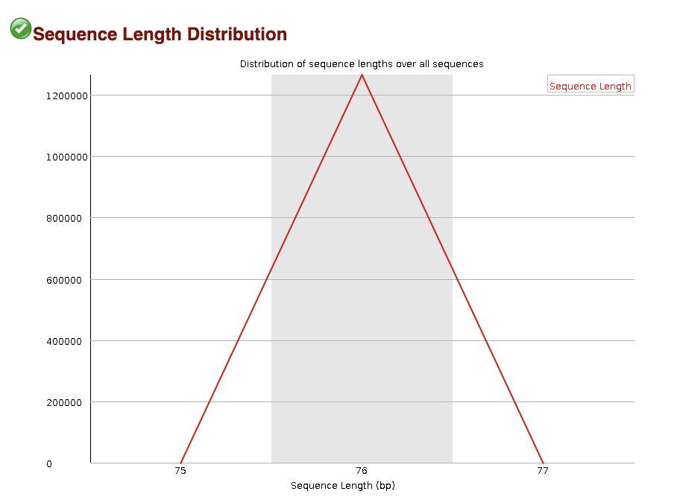

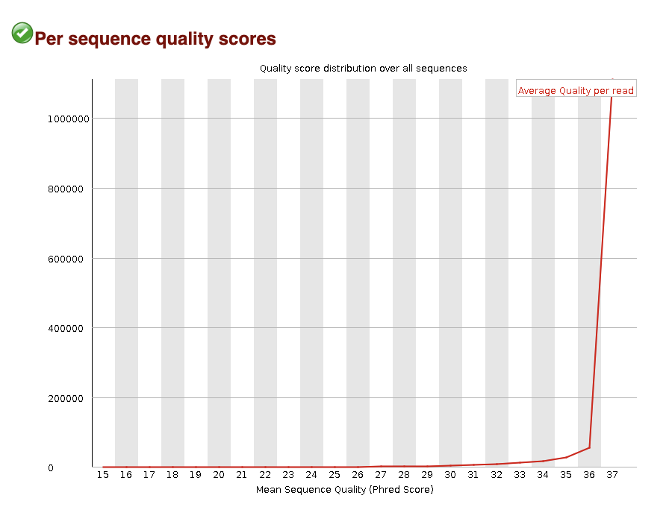

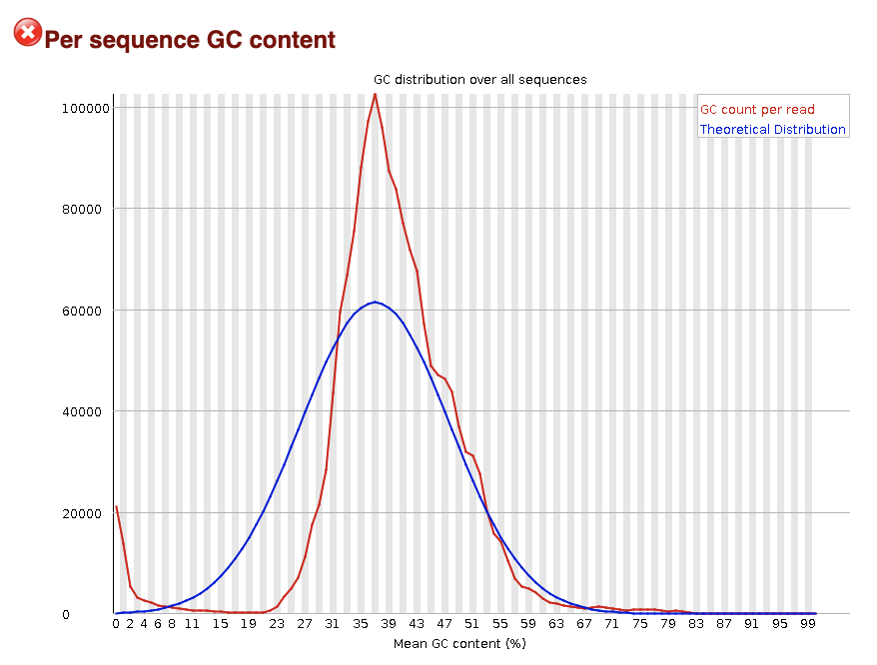

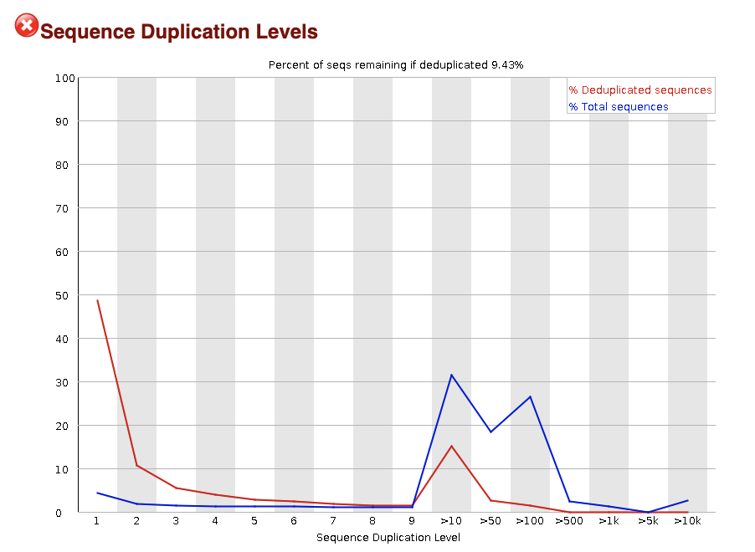

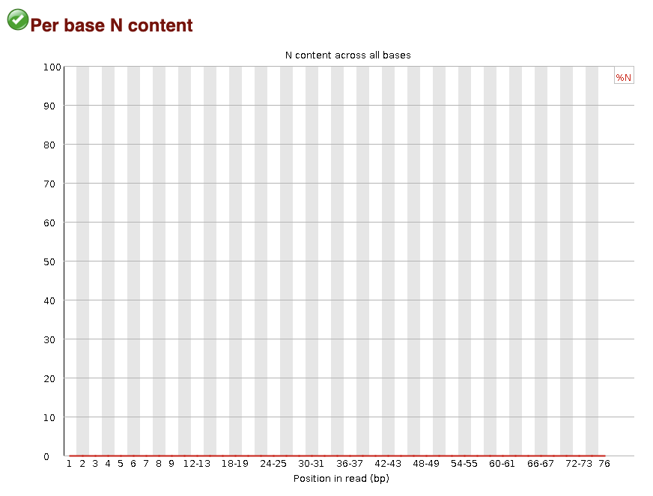
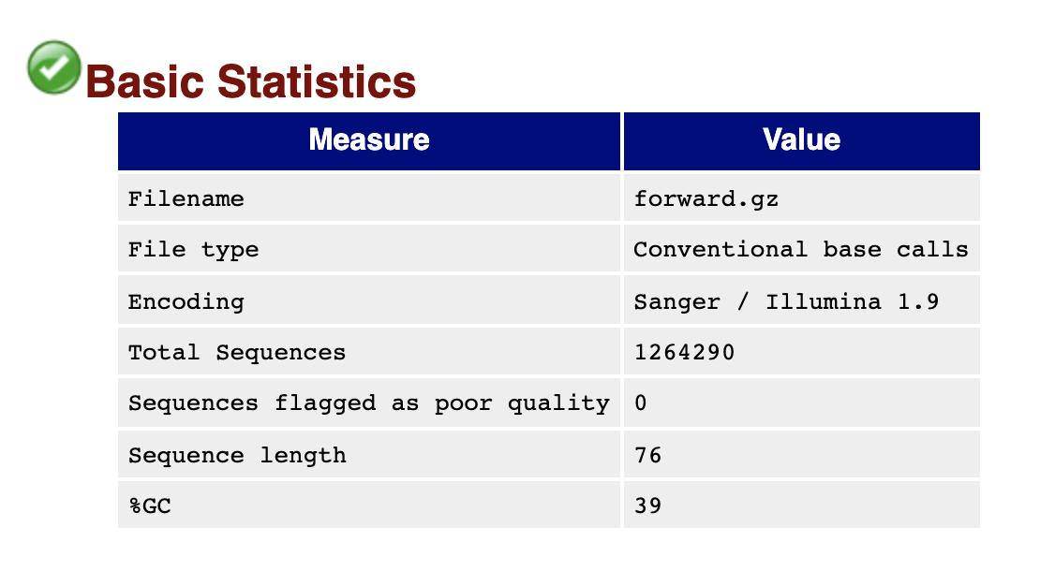
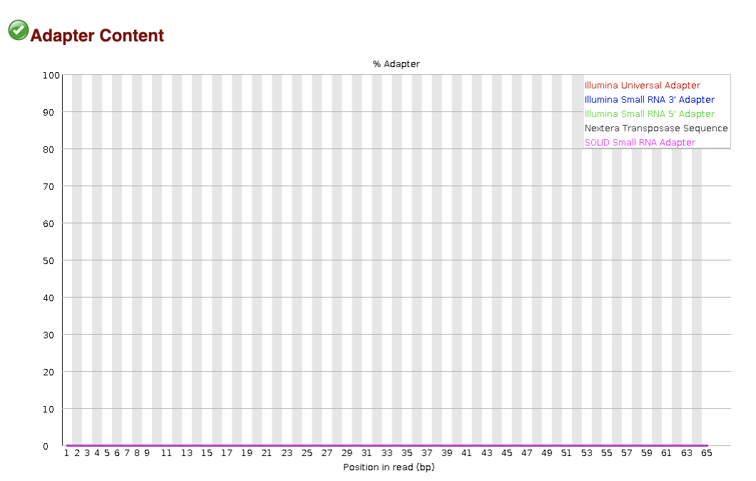

FastQC
Quality
Characteristics

Slide 14
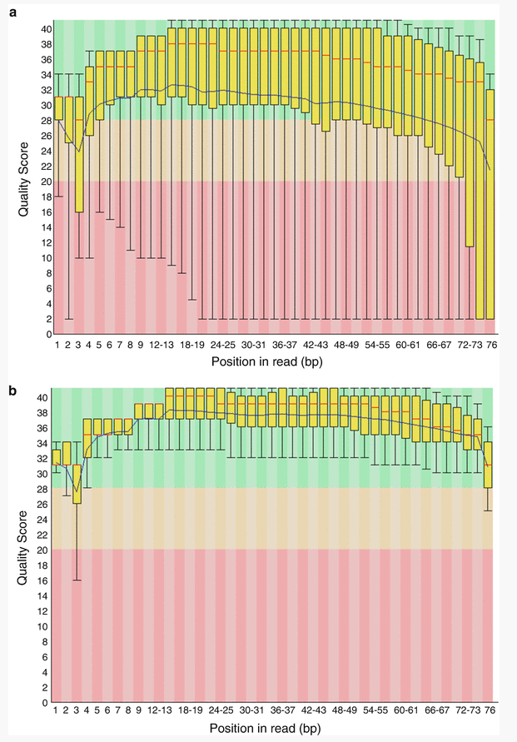
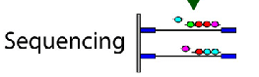
FastQC: Sequence Quality Histogram
Quality Score
Position in read (bp)
Position in read (bp)
GOOD
High quality over the length of the read
BAD
Read quality drops at the beginning and end

Slide 15
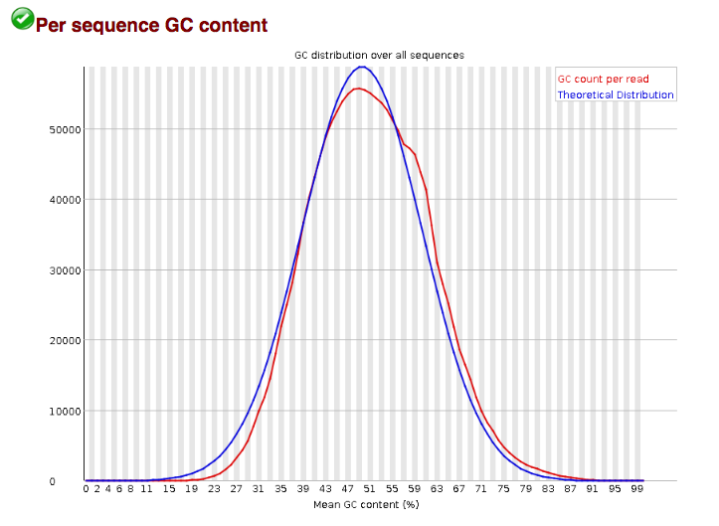
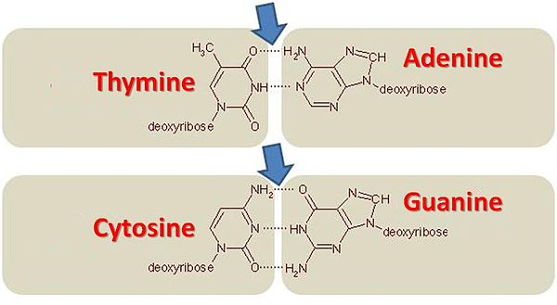
FastQC: Per sequence GC content
Number of Reads
Mean GC content (%)
Notes:
GC-content (or guanine-cytosine content) is the percentage of bases in a DNA or RNA molecule that are either G or C out of an implied four total bases.
The FastQC plot is a histogram of the number of reads on the y axis, and the mean GC % of the reads in that bin.
So this peaks around 50%, so most reads have between 40-60% of GC%

Slide 16
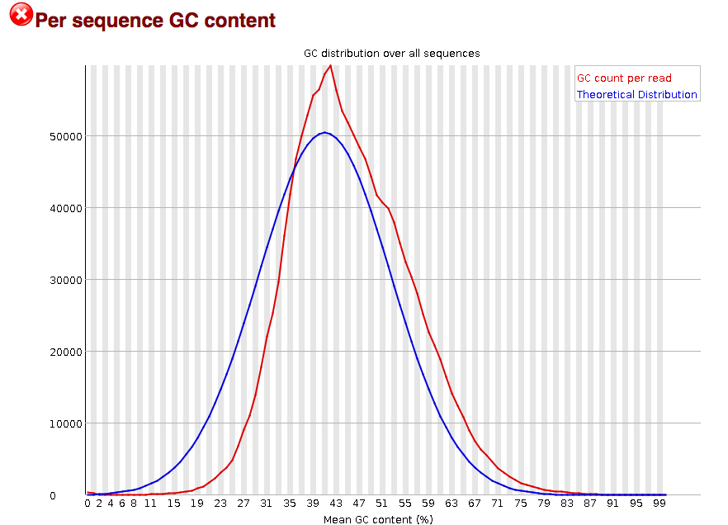
FastQC: Per sequence GC content
Number of Reads
Mean GC content (%)
Mean GC content (%)
Mean GC content (%)
GOOD: follows normal distribution (sum of deviations is < 15% of reads)
BAD: can indicate contamination with adapter dimers, or another species
Notes:
In a normal random library you would expect to see a roughly normal distribution of GC content where the central peak corresponds to the overall GC content of the underlying genome.
Since we don't know the the GC content of the genome, a theoretical distribution (blue) is created based on observed distribution.
An unusually shaped distribution could indicate a contaminated library or some other kinds of biased subset of reads mixed in.
Sharp peaks on an otherwise smooth distribution are normally the result of a specific contaminant (adapter dimers for example), which may well be picked up by the overrepresented sequences module. Broader peaks may represent contamination with a different species.

Slide 17
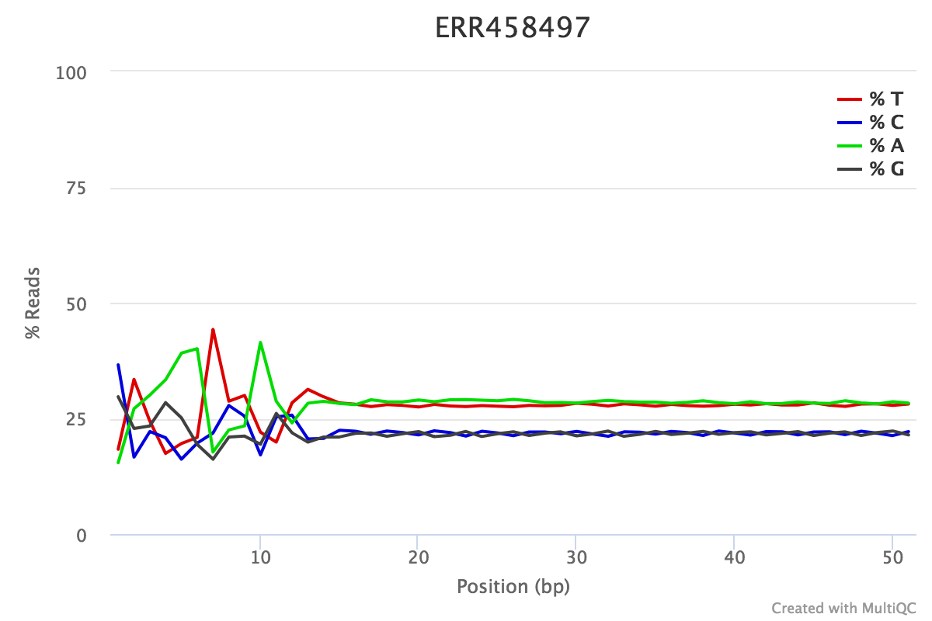
FastQC: Per Base Sequence Content
% Reads
Position (bp)
Proportion of each position for which each DNA base has been called
RNAseq data tends to show a positional sequence bias in the first ~12 bases
The "random" priming step during library construction is not truly random and certain hexamers are more prevalent than others
sequencing.qcfail.com
Notes:
This plot shows the position along the read ( x axis) and the proportion of all reads for which each DNA base has been called (y axis)
RNAseq data tends to show a positional sequence bias in the first ~12 bases
The "random" priming step during library construction is not truly random and certain hexamers are more prevalent than others
Studies have shown that this does NOT cause mis-called bases or drastic bias in sequenced fragments Read quality drops at the beginning and end
This biased distribution is expected for RNAseq

Slide 18
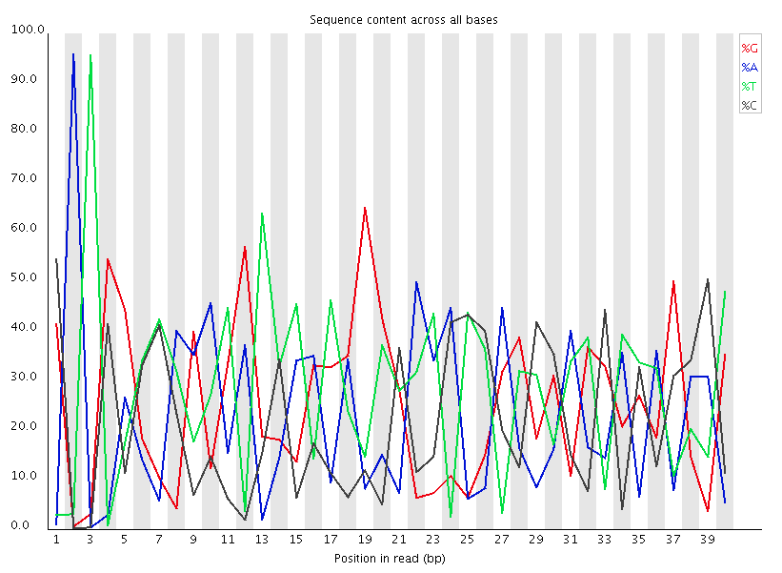
FastQC: Per Base Sequence Content
EXPECTED for RNAseq
BAD:
Shows a strong positional bias throughout the reads, which in this case is due to the library having a certain sequence that is overrepresented
Notes:
Could be adapter-dimer contamination or other

Slide 19
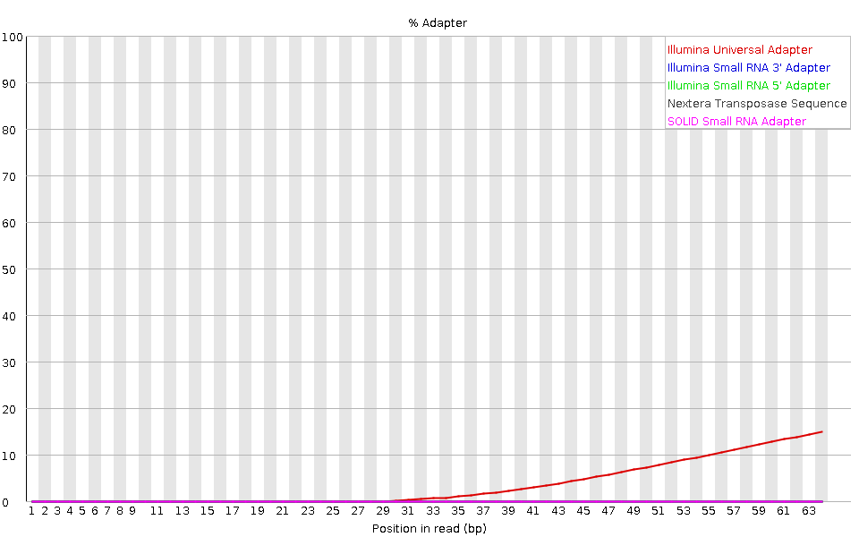
FastQC: Adapter content
Adapters
FastQC will scan each read for the presence of known adapter sequences
The plot shows that the adapter content rises over the course of the read
Solution – Adapter trimming!
Position in read (bp)
sequencing.qcfail.com

Slide 20
Create a new history

Slide 21

Access Galaxy
1. Connect to Tufts Network, either on campus or via VPN
2. Visit https://galaxy.cluster.tufts.edu/
3. Log in with you cluster username and password
4. In another browser window go to course workflow: https://rbatorsky.github.io/intro-to-galaxy-ngs-sarscov2/
Suggested screen layout

Slide 22
Outline
Bulk and single cell RNA sequencing
Intro to Galaxy Platform for Bioinformatics (Tufts network or VPN required)
https://galaxy.cluster.tufts.edu/
Work through RNAseq example together on Galaxy
https://rbatorsky.github.io/intro-to-rnaseq-with-galaxy/
2 days!
Notes:
I’d prefer you use the raise hand to ask question and lower it after. If I don’t see it, feel free to interrupt.
Can I get a show of hands of who has experience in bioinformatics?
How about anyone with experience in NGS sequencing?
With Galaxy?

Slide 23
>NC_045512.2 Severe acute respiratory syndrome coronavirus 2 isolate Wuhan-Hu-1, complete genome
ATTAAAGGTTTATACCTTCCCAGGTAACAAACCAACCAACTTTCGATCTCTTGTAGATCTGTTCTCTAAACGAACTTTAA
AATCTGTGTGGCTGTCACTCGGCTGCATGCTTAGTGCACTCACGCAGTATAATTAATAACTAATTACTGTCGTTGACAGG
ACACGAGTAACTCGTCTATCTTCTGCAGGCTGCTTACGGTTTCGTCCGTGTTGCAGCCGATCATCAGCACATCTAGGTTT
Sequence identifier
Sequence

Slide 24
>NC_045512.2 Severe acute respiratory syndrome coronavirus 2 isolate Wuhan-Hu-1, complete genome
ATTAAAGGTTTATACCTTCCCAGGTAACAAACCAACCAACTTTCGATCTCTTGTAGATCTGTTCTCTAAACGAACTTTAA
AATCTGTGTGGCTGTCACTCGGCTGCATGCTTAGTGCACTCACGCAGTATAATTAATAACTAATTACTGTCGTTGACAGG
ACACGAGTAACTCGTCTATCTTCTGCAGGCTGCTTACGGTTTCGTCCGTGTTGCAGCCGATCATCAGCACATCTAGGTTT
Sequence identifier
Sequence

Slide 25
Raw reads in Fastq format
@SRR098401.109756285
GACTCACGTAACTTTAAACTCTAACAGAAATATACTA…
+
CAEFGDG?BCGGGEEDGGHGHGDFHEIEGGDDDD…
Sequence identifier
Sequence
+ (optionally lists the sequence identifier again)
Quality string

Slide 26
Raw reads in Fastq format
@SRR098401.109756285
GACTCACGTAACTTTAAACTCTAACAGAAATATACTA…
+
CAEFGDG?BCGGGEEDGGHGHGDFHEIEGGDDDD…
Sequence identifier
Sequence
+ (optionally lists the sequence identifier again)
Quality string

Slide 27
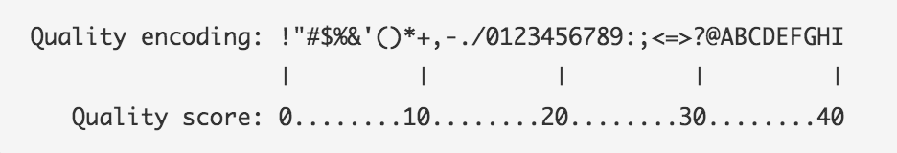
Base Quality Scores
The symbols we see in the read quality string are an encoding of the quality score:
A quality score is a prediction of the probability of an error in base calling:
Quality Score | Probability of Incorrect Base Call | Inferred Base Call Accuracy
10 (Q10) | 1 in 10 | 90%
20 (Q20) | 1 in 100 | 99%
30 (Q30) | 1 in 1000 | 99.9%
https://www.illumina.com/science/education/sequencing-quality-scores.html
Notes:
Q = -log_10(e), e = probability of error

Slide 28
Base Quality Scores
The symbols we see in the read quality string are an encoding of the quality score:
A quality score is a prediction of the probability of an error in base calling:
Quality Score | Probability of Incorrect Base Call | Inferred Base Call Accuracy
10 (Q10) | 1 in 10 | 90%
20 (Q20) | 1 in 100 | 99%
30 (Q30) | 1 in 1000 | 99.9%
Back to our read:
@SRR098401.109756285
GACTCACGTAACTTTAAACTCTAACAGAAATATACTA…
+
CAEFGDG?BCGGGEEDGGHGHGDFHEIEGGDDDD…
C –> Q = 34 -> Probability < 1/1000 of an error
https://www.illumina.com/science/education/sequencing-quality-scores.html

Slide 29
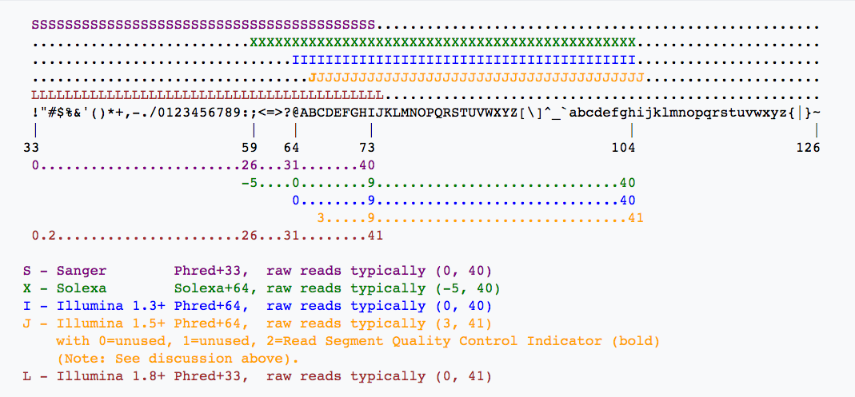
Base Quality Scores
Quality encoding
Quality scores
https://en.wikipedia.org/wiki/FASTQ_format

Slide 30
Raw read quality control
Sequence Quality
GC content
Per base sequence content
Adapters in Sequence

Slide 31
Let’s do it
In order to count genes, we need to know where they are located in the reference sequence
STAR uses a Gene Transfer Format (GTF) file for gene annotation
Frame
Strand
Chrom
Source
Feature type
Start
Stop
(Score)
Attribute
SeqID | Source | Type | Start | End | Score | Strand | Phase | Attributes
## HEADER LINES
NC_045512.2 | RefSeq | region | 1 | 29903 | . | + | . | ID=NC_045512.2:1..29903
NC_045512.2 | RefSeq | gene | 266 | 21555 | . | + | . | ID=gene-GU280_gp01
NC_045512.2 | RefSeq | CDS | 266 | 13468 | . | + | 0 | ID=cds-YP_009724389.1

Slide 32
FastQC: Sequence Quality Histogram
Quality Score
Position in read (bp)
Position in read (bp)
GOOD
High quality over the length of the read
BAD
Read quality drops at the beginning and end

Slide 33
FastQC: Per sequence GC content
Number of Reads
Mean GC content (%)
Notes:
GC-content (or guanine-cytosine content) is the percentage of bases in a DNA or RNA molecule that are either G or C out of an implied four total bases.
The FastQC plot is a histogram of the number of reads on the y axis, and the mean GC % of the reads in that bin.
So this peaks around 50%, so most reads have between 40-60% of GC%

Slide 34
FastQC: Per sequence GC content
Number of Reads
Mean GC content (%)
Mean GC content (%)
Mean GC content (%)
GOOD: follows normal distribution (sum of deviations is < 15% of reads)
BAD: can indicate contamination with adapter dimers, or another species
Notes:
In a normal random library you would expect to see a roughly normal distribution of GC content where the central peak corresponds to the overall GC content of the underlying genome.
Since we don't know the the GC content of the genome, a theoretical distribution (blue) is created based on observed distribution.
An unusually shaped distribution could indicate a contaminated library or some other kinds of biased subset of reads mixed in.
Sharp peaks on an otherwise smooth distribution are normally the result of a specific contaminant (adapter dimers for example), which may well be picked up by the overrepresented sequences module. Broader peaks may represent contamination with a different species.

Slide 35
FastQC: Per Base Sequence Content
% Reads
Position (bp)
Proportion of each position for which each DNA base has been called
RNAseq data tends to show a positional sequence bias in the first ~12 bases
The "random" priming step during library construction is not truly random and certain hexamers are more prevalent than others
sequencing.qcfail.com
Notes:
This plot shows the position along the read ( x axis) and the proportion of all reads for which each DNA base has been called (y axis)
RNAseq data tends to show a positional sequence bias in the first ~12 bases
The "random" priming step during library construction is not truly random and certain hexamers are more prevalent than others
Studies have shown that this does NOT cause mis-called bases or drastic bias in sequenced fragments Read quality drops at the beginning and end
This biased distribution is expected for RNAseq

Slide 36
FastQC: Per Base Sequence Content
EXPECTED for RNAseq
BAD:
Shows a strong positional bias throughout the reads, which in this case is due to the library having a certain sequence that is overrepresented
Notes:
Could be adapter-dimer contamination or other

Slide 37
FastQC: Adapter content
Adapters
FastQC will scan each read for the presence of known adapter sequences
The plot shows that the adapter content rises over the course of the read
Solution – Adapter trimming!
Position in read (bp)
sequencing.qcfail.com

Slide 38
Adapter trimming
Trim Galore! is a tool that:
Scans and removes known Illumina or custom adapters
Performs read trimming for low quality regions at the end of reads
Removes reads that become too short in the trimming process

Slide 39
Our Workflow
Obtain data from NCBI
Process Raw Reads (QC, adapter trimming)
Read Alignment
Visualization
Notes:
Note that this will get pretty technical pretty quickly, with the nuts and bolts of the RNAseq workflow.
I expect you will be able to follow the slides, but please feel free to ask questions.
After this overview, we’ll go through it together and perform the steps.

Slide 40
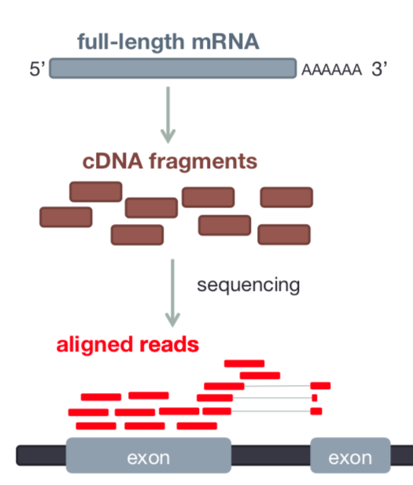
Read Alignment
RNAseq data originates from spliced mRNA (no introns)
When aligning to the genome, our aligner must find a spliced alignment for reads
We use a tool called STAR (Spliced Transcripts Alignment to a Reference) that has a exon-aware mapping algorithm.
Reference sequence
Dobin et al Bioinformatics 2013

Slide 41
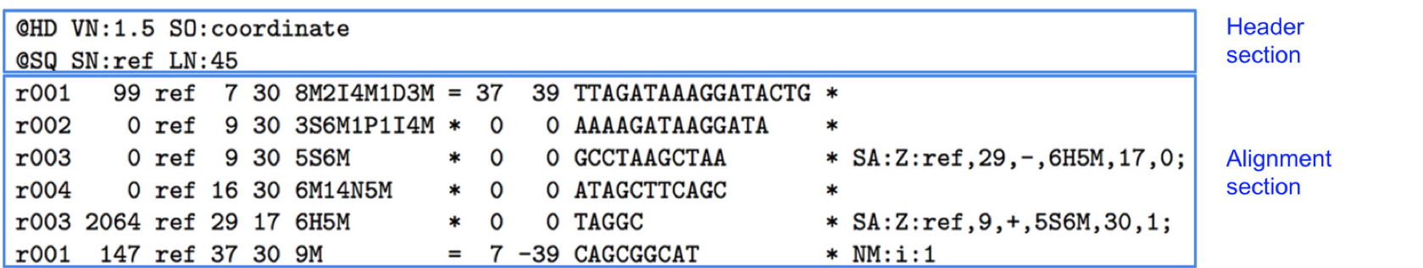
Sequence Alignment Map (SAM)
Reference seq
Reads
TTAGAT
GATAAC
CIGAR: summary of alignment, e.g. match, gap, insertion, deletion
Mapping Quality
Position
Ref Sequence name
Flag: indicates alignment information e.g. paired, aligned, etc
https://broadinstitute.github.io/picard/explain-flags.html
Read ID
www.samformat.info

Slide 42
Sequence Alignment Map (SAM)
Reference seq
Reads
TTAGAT
GATAAC
Paired end info
Optional Fields
Quality Score
Sequence
www.samformat.info

Slide 43
Gene Annotation Format (GTF)
In order to count genes, we need to know where they are located in the reference sequence
STAR uses a Gene Transfer Format (GTF) file for gene annotation
Frame
Strand
Chrom
Source
Feature type
Start
Stop
(Score)
Attribute
chr5 | hg38_refGene | exon | 138465492 | 138466068 | . | + | . | gene_id "EGR1";
chr5 | hg38_refGene | CDS | 138465762 | 138466068 | . | + | 0 | gene_id "EGR1";
chr5 | hg38_refGene | start_codon | 138465762 | 138465764 | . | + | . | gene_id "EGR1";
chr5 | hg38_refGene | CDS | 138466757 | 138468078 | . | + | 2 | gene_id "EGR1";
chr5 | hg38_refGene | exon | 138466757 | 138469315 | . | + | . | gene_id "EGR1";
chr5 | hg38_refGene | stop_codon | 138468079 | 138468081 | . | + | . | gene_id "EGR1";
https://useast.ensembl.org/info/website/upload/gff.html

Slide 44
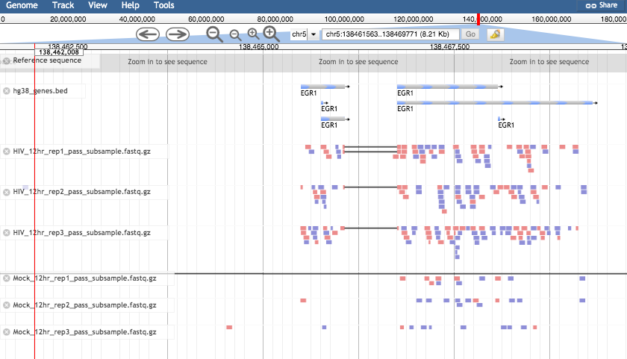
Visualizing reads with JBrowse

